Slide 1
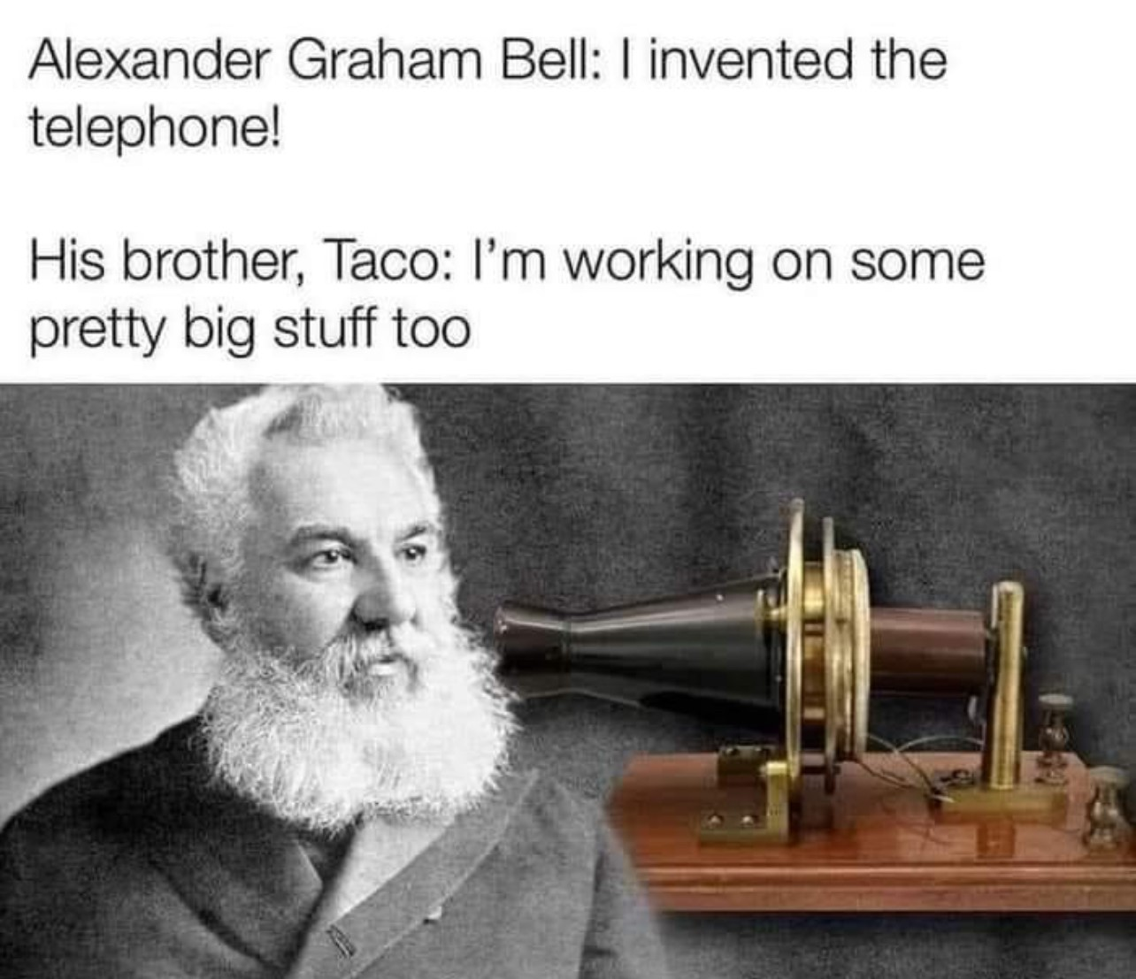
Communications

Slide 2
What is Satellite Communication?
Satellite Broadcasting
Point to point communication through satellite relay
Communication to/from a Satellite

Slide 3
Sat Comm Architecture
Satellite Relay
Store and forward
Geostationary
Molnyia
Bent pipe
Cross-linked spacecraft

Slide 4
Comm with a satellite
Dedicated ground station
Remote terminal
Own network (NASA deep space)
Lease (AWS)
Spacecraft Relay

Slide 5
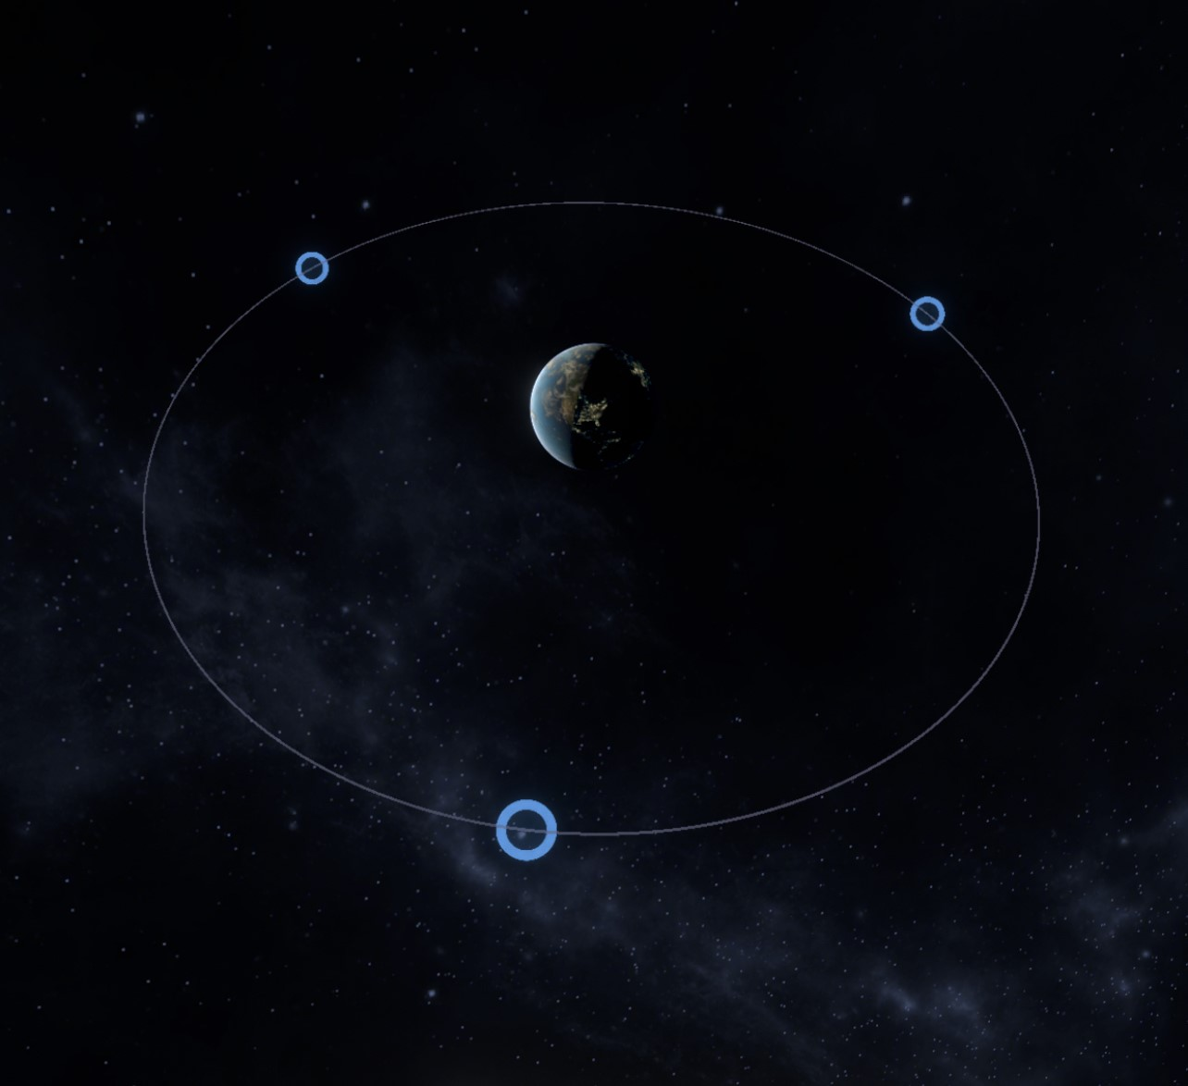
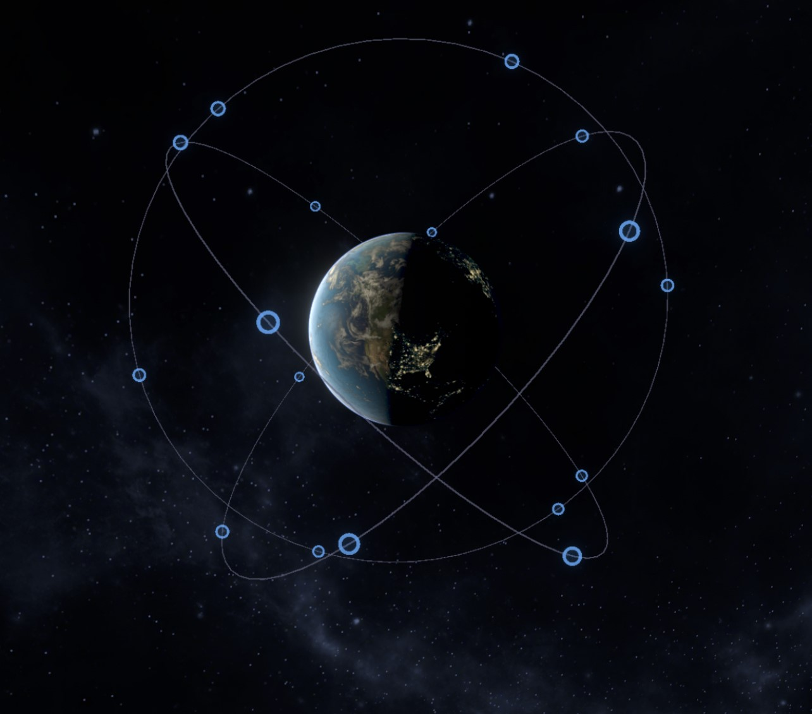
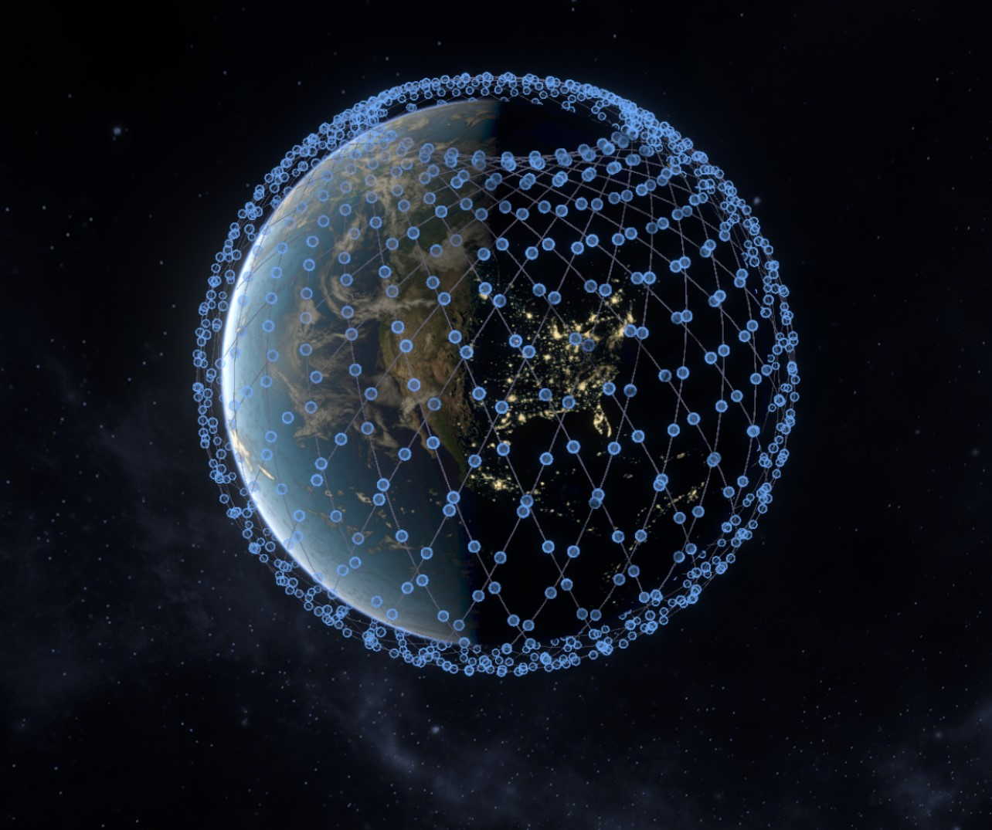

Slide 6
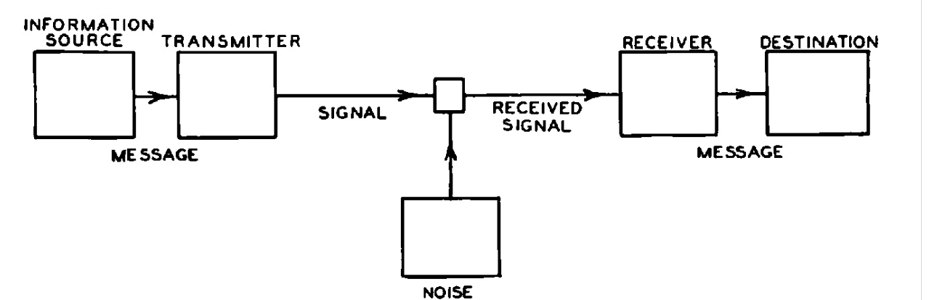
Performance
Is signal sufficient for understanding?

Slide 7
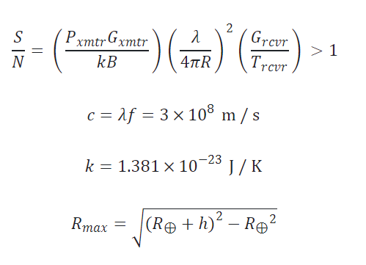
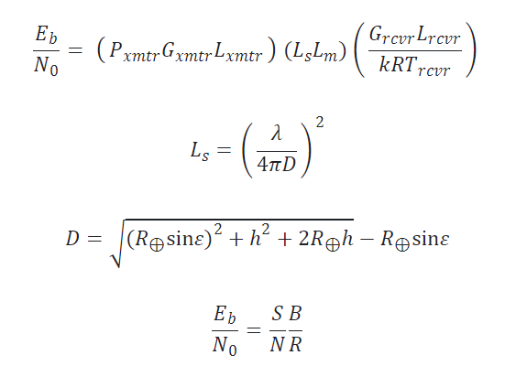
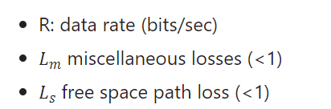
Equations
Astro 310
Astro 331

Slide 8
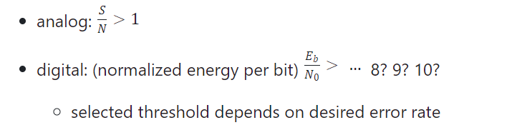
Differences
BER (bit error rate) – ratio of number of bits received in error to total number transmitted
Eb/No – ratio of energy per bit to noise power spectral density

Slide 9
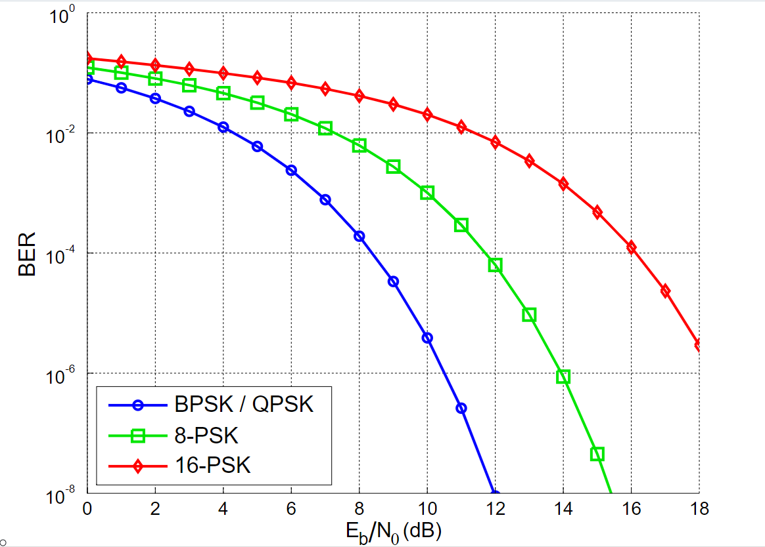
Notes:
BPSK – binary phase shift key
Higher = higher transmission rates

Slide 10
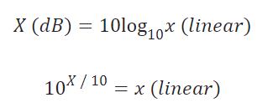
Decibels
To simplify, comm engineers work in Decibels (dB)
Logrithms
Turn multiplication into addition
Turn division into subtraction
Map enormous range in smaller space
Notes:
45-65 Db is 100 times more intense
50 – 100 Db is 100,000 times more intense

Slide 11
Decibel
Decibel is a ratio, multiplying by one is like adding 0
Adding 3 dB doubles the signal strength
Things that amplify or attenuate a signal
Amplifier
Transmission line loss
Notes:
45-65 Db is 100 times more intense
50 – 100 Db is 100,000 times more intense

Slide 12
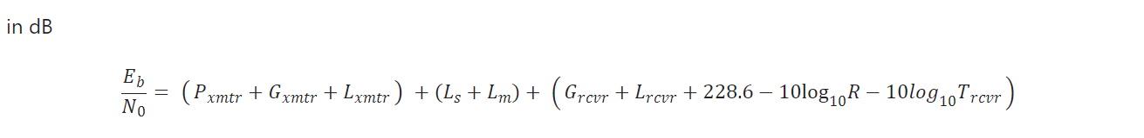
Decibel
Units
dBm = decibels relative to 1mW
dBW = decibels relative to 1 W

Slide 13
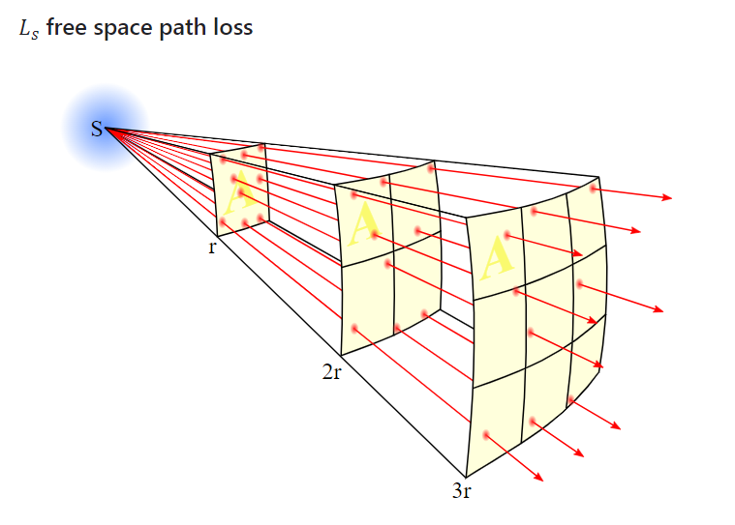

Terms
$$L_{s}= {\left(\frac{λ}{4πS}\right)}^{2}$$

Slide 14



Terms

Slide 15
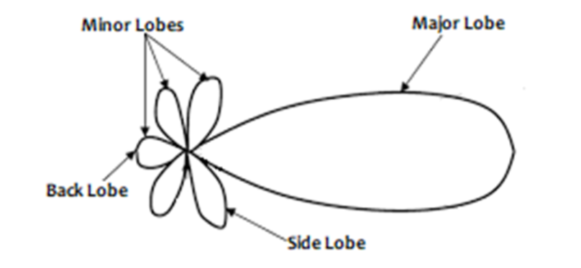
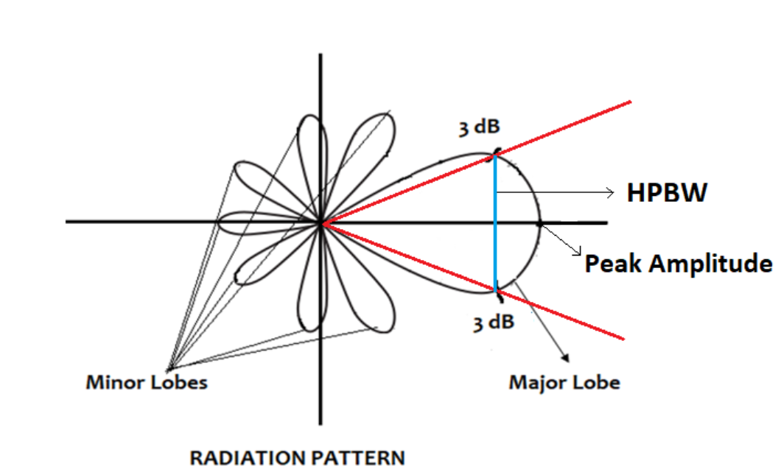
Half Power Beam width

Slide 16
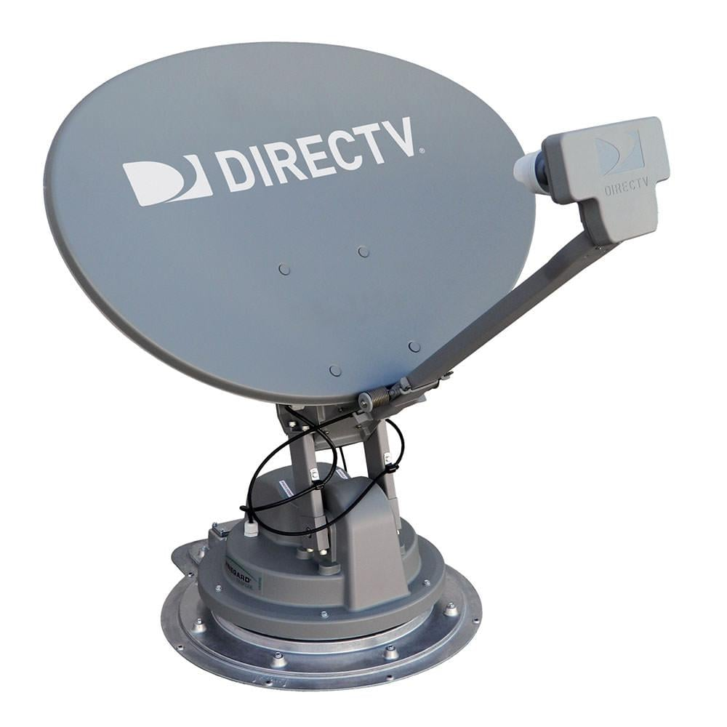
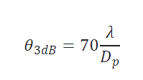
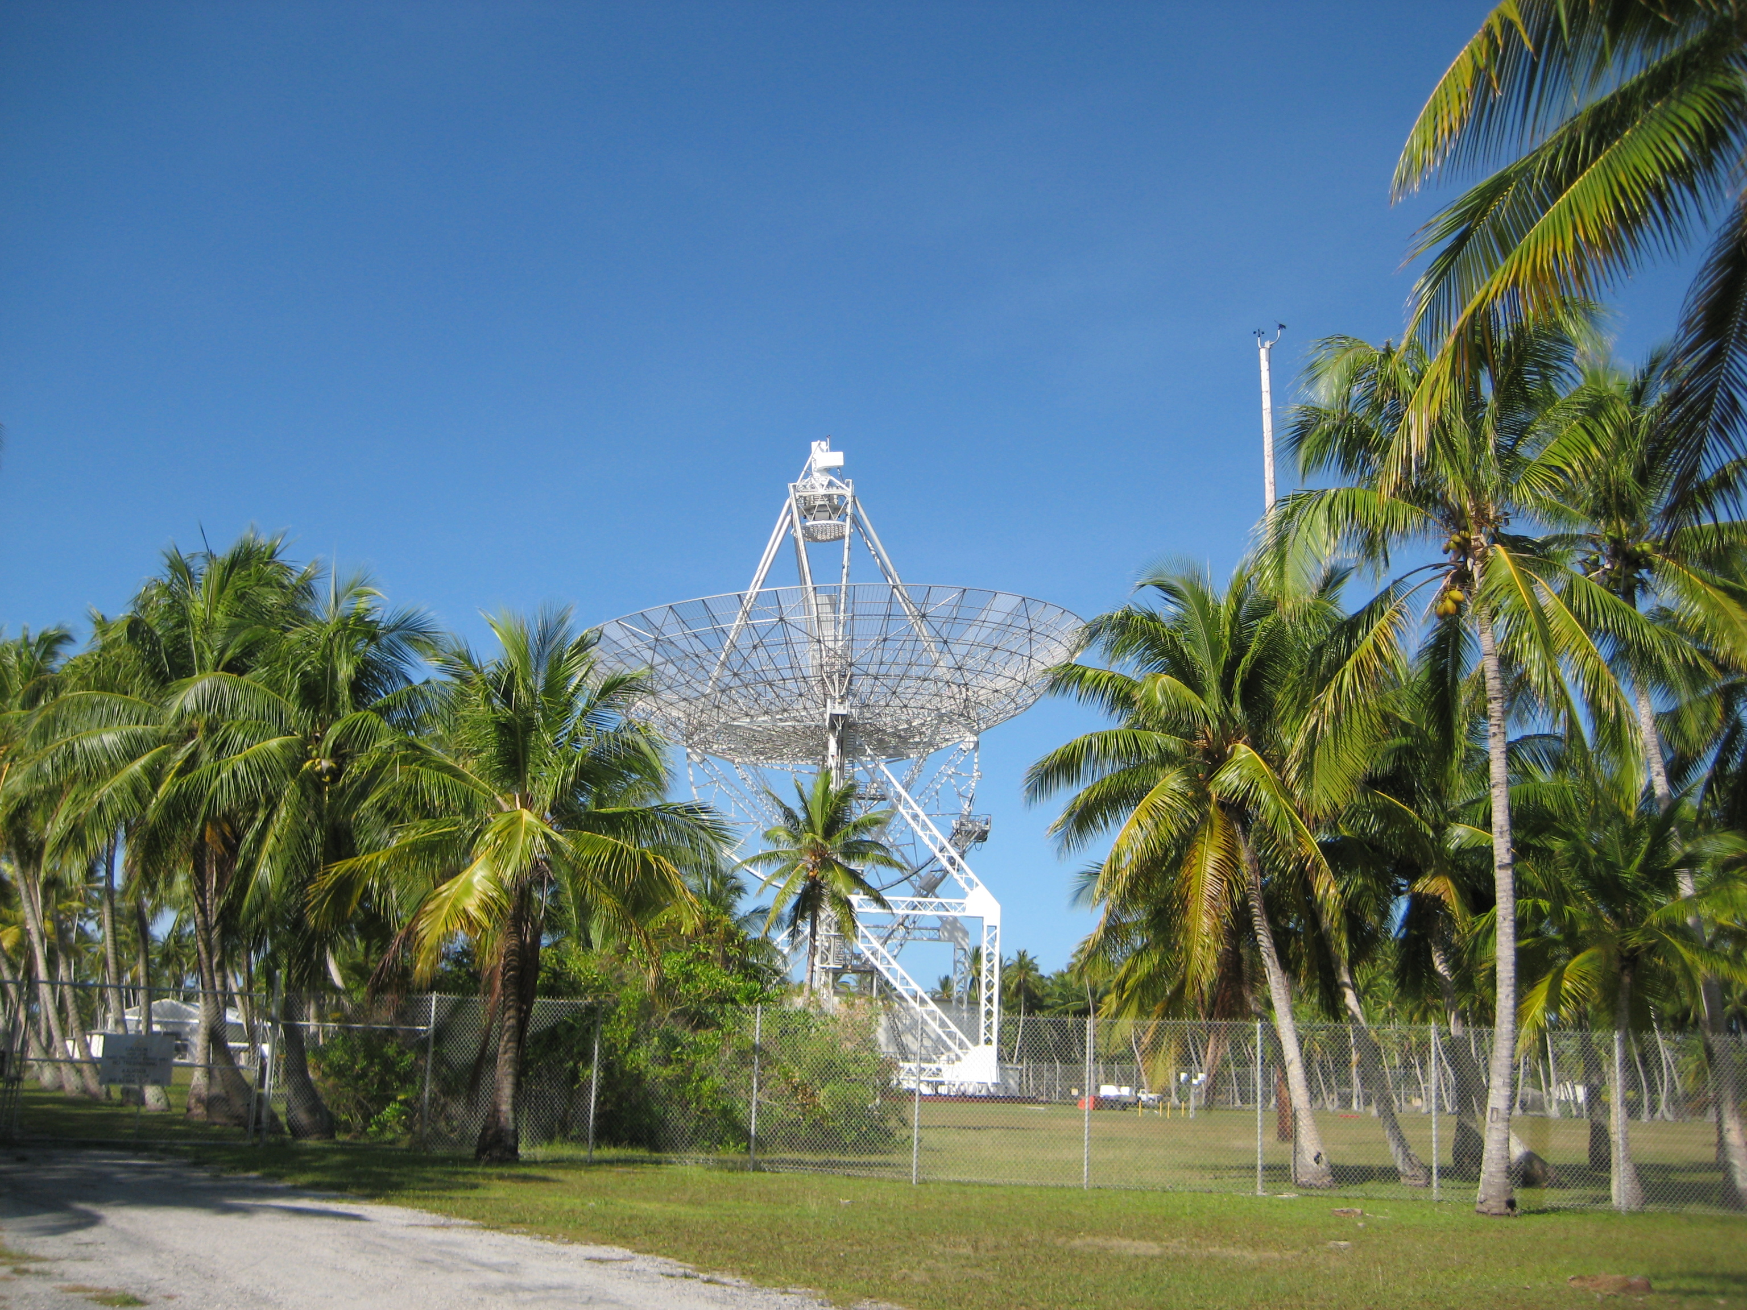

Parabolic dish

Slide 17
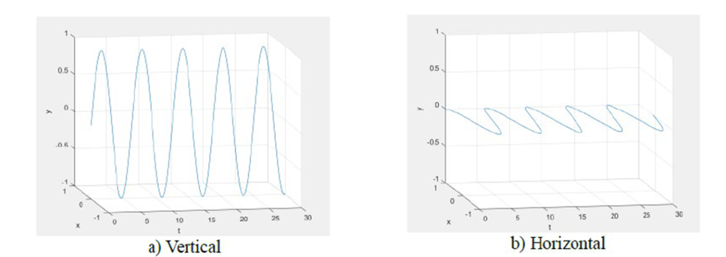

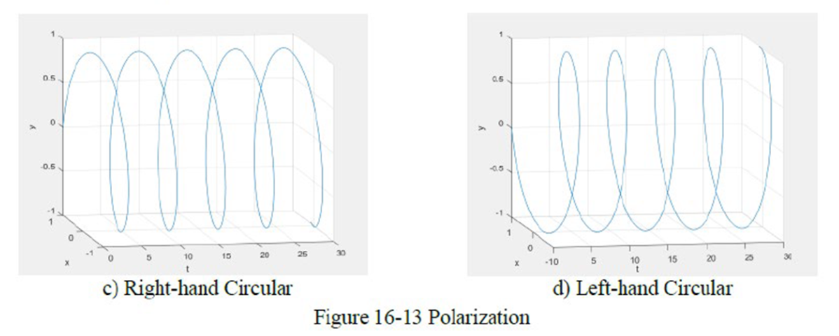
Polarization losses

Slide 18
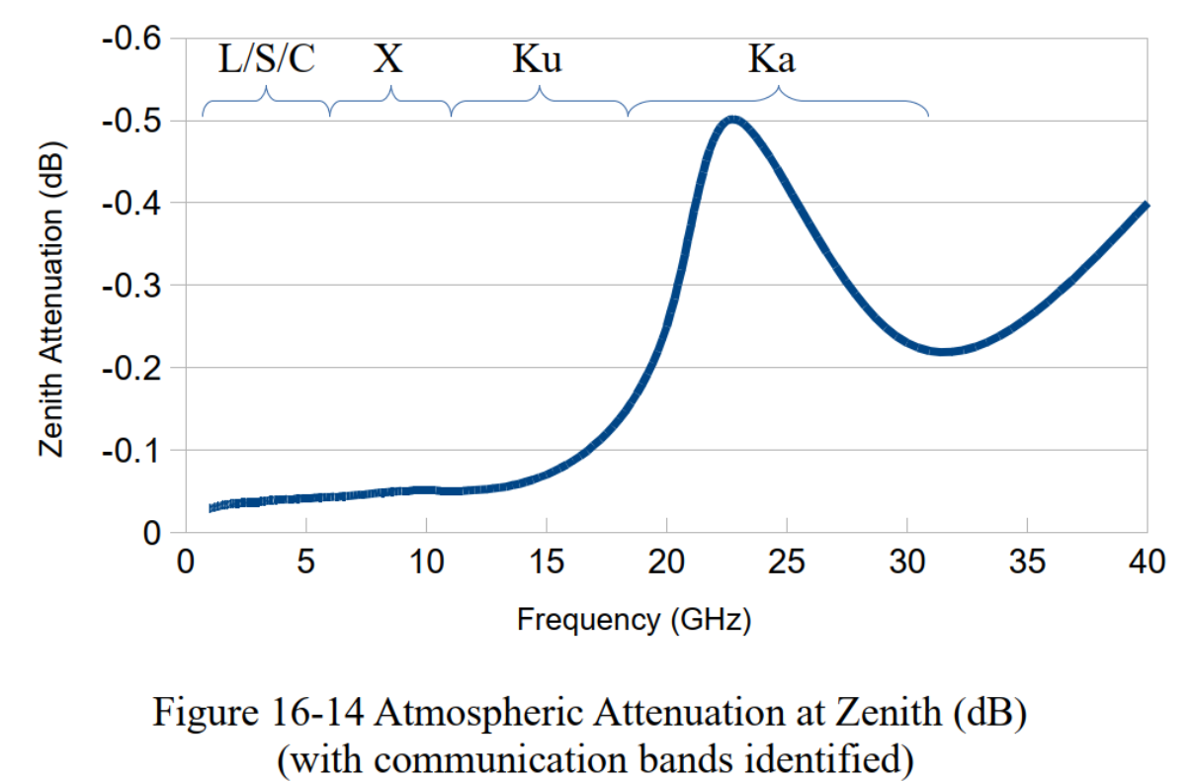
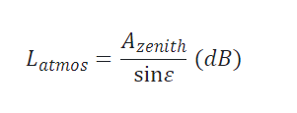
Atmospheric Losses

Slide 19
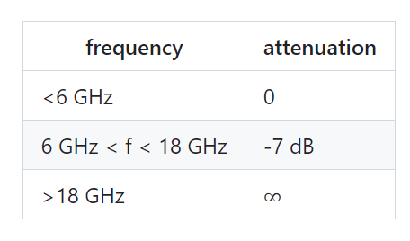
Rain Losses

Slide 20


Gain
Directionally compared to an isotropic antenna
Amplification (positive)
Dipole antenna gain = 2.15 dBi (%58 higher)
Parabolic Gain
Notes:
dBi = isotropic

Slide 21
